Slide 1
Wine Quality Prediction: A Data Science Approach
CODE (GOOGLE COLAB) ctrl +click
DATASETS ctrl+ click

Slide 2

Problem Statement
Wine quality is a crucial factor in the wine industry, affecting consumer preference and market value. Traditionally, wine quality is assessed through human sensory evaluation, which is subjective, time-consuming, and expensive. This project aims to develop a machine learning model to predict wine quality based on its chemical properties, such as acidity, alcohol content, pH levels, and sugar concentration.

Slide 3
The attributes commonly used in wine quality prediction are: Fixed Acidity: The amount of non-volatile acids in the wine, primarily tartaric acid. Volatile Acidity: The amount of acetic acid in the wine, which can give it a vinegar-like taste if present in high amounts. Citric Acid: A preservative that adds freshness and flavor to wines. Residual Sugar: The amount of sugar remaining after fermentation. Chlorides: The amount of salt in the wine. Free Sulfur Dioxide: A preservative that prevents microbial growth and oxidation. Total Sulfur Dioxide: The total amount of free and bound forms of sulfur dioxide. Density: The density of the wine, which is related to its alcohol content and sugar level. pH: A measure of the acidity or alkalinity of the wine. Sulphates: A wine additive that contributes to sulfur dioxide levels and acts as an antimicrobial and antioxidant.

Slide 4
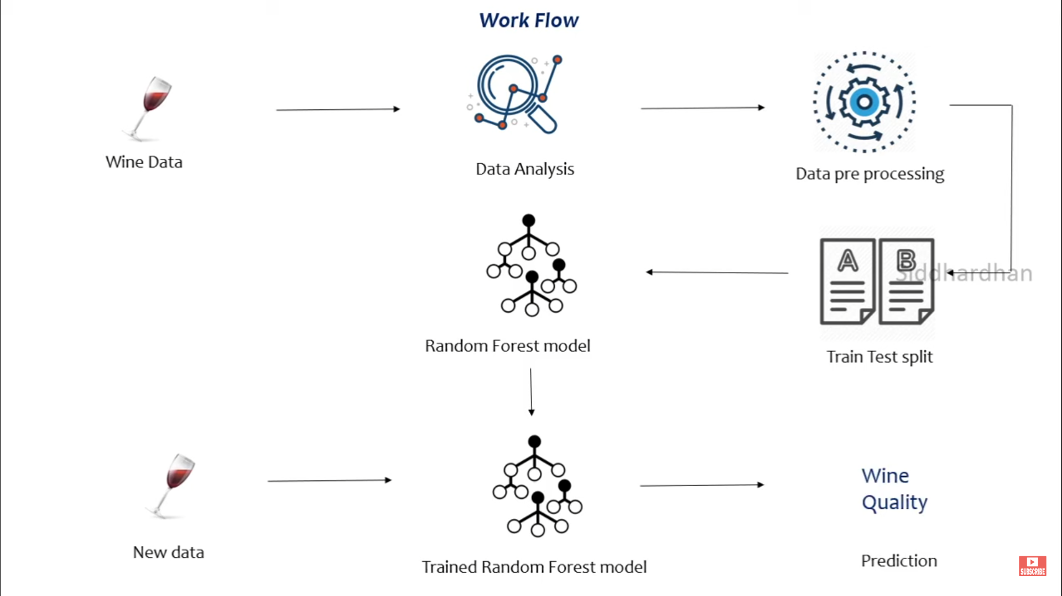

Slide 5
Data analysis and visualization :NumPy , Pandas, Matplotlib, Python

Slide 6
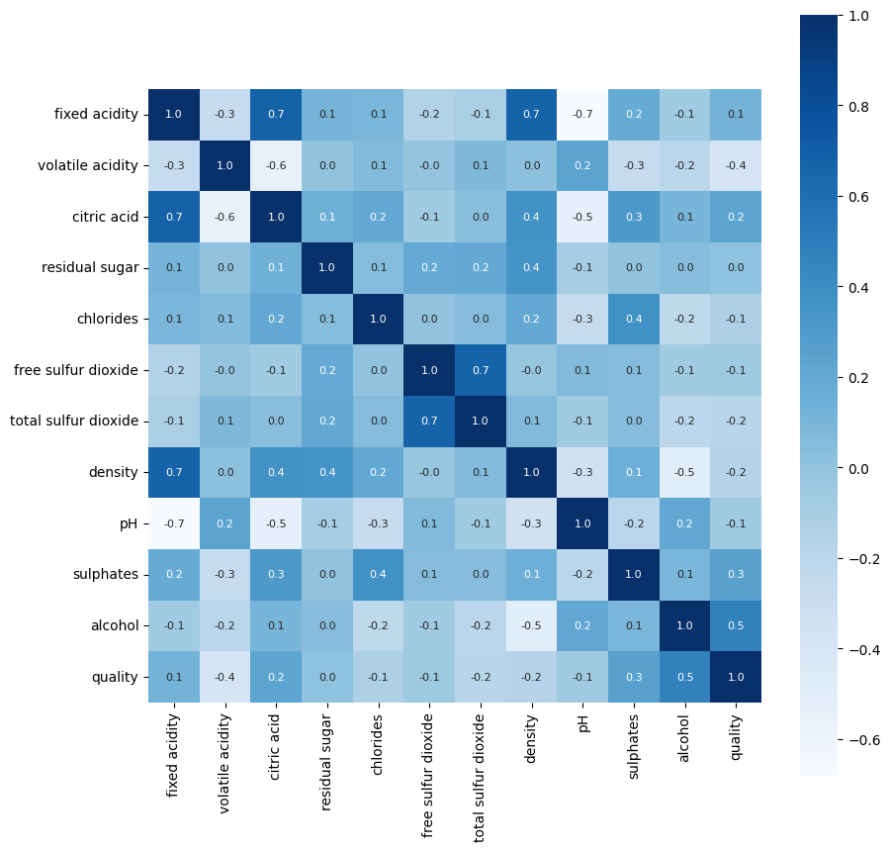
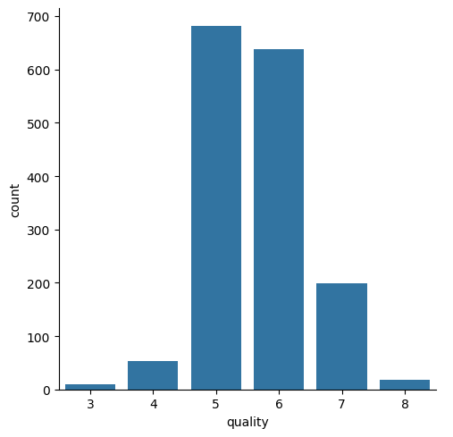
Data analysis

Slide 7
Datasets
Ctrl + click to follow link :
colab code
Thankyou

